Slide 1


Benign vs. Malignant Characteristics For Breast Cancer
Predicting whether a mass is Just a Tumor Or Is cancerous

Slide 2
Data Source
Dr. William H. Wolberg from the General Surgery Dept at the University of Wisconsin, shared via Kaggle.
Digital images of a breast mass, characteristics of the cell nuclei present in the imaged cataloged into 10 categories:
radius, texture, perimeter, area, smoothness, compactness, concavity, concave points, symmetry, fractal dimension.
Mean, standard error, and the worst/largest of these features were computed to each image.

Slide 3
Defining Terms
Benign: A mass that is centralized and does not spread to other areas. They respond well to treatment. If left untreated it can continue to grow and cause problems to size alone.
Malignant: A mass that is a cancerous growth. Difficult to treat and spread to other areas in the body. They can recur after removed.
Source: [Johns Hopkins]

Slide 4
Using the Data
Looking at the findings will help doctors to be able to see, through imaging, if the mass is benign or malignant. Knowing which characteristics of the mass indicate benign or malignant help the doctors better determine which type of mass they are dealing with.
Knowing the type of mass, either a tumor or cancer, helps to expedite the creation of the patient's treatment plan. Moving forward in the correct treatment sooner will expedite the process.
With more detail in digging into the findings will help fewer masses being labeled as inconclusive. Having an exact diagnosis early on is critical to the survival of the patient.

Slide 5
Hypotheses
H₀: µ₁ = µ₂
There will be statistical similarities between the benign and malignant data.
Hₐ: µ₁ ≠ µ₂
There will be statistical differences between the benign and malignant data.

Slide 6
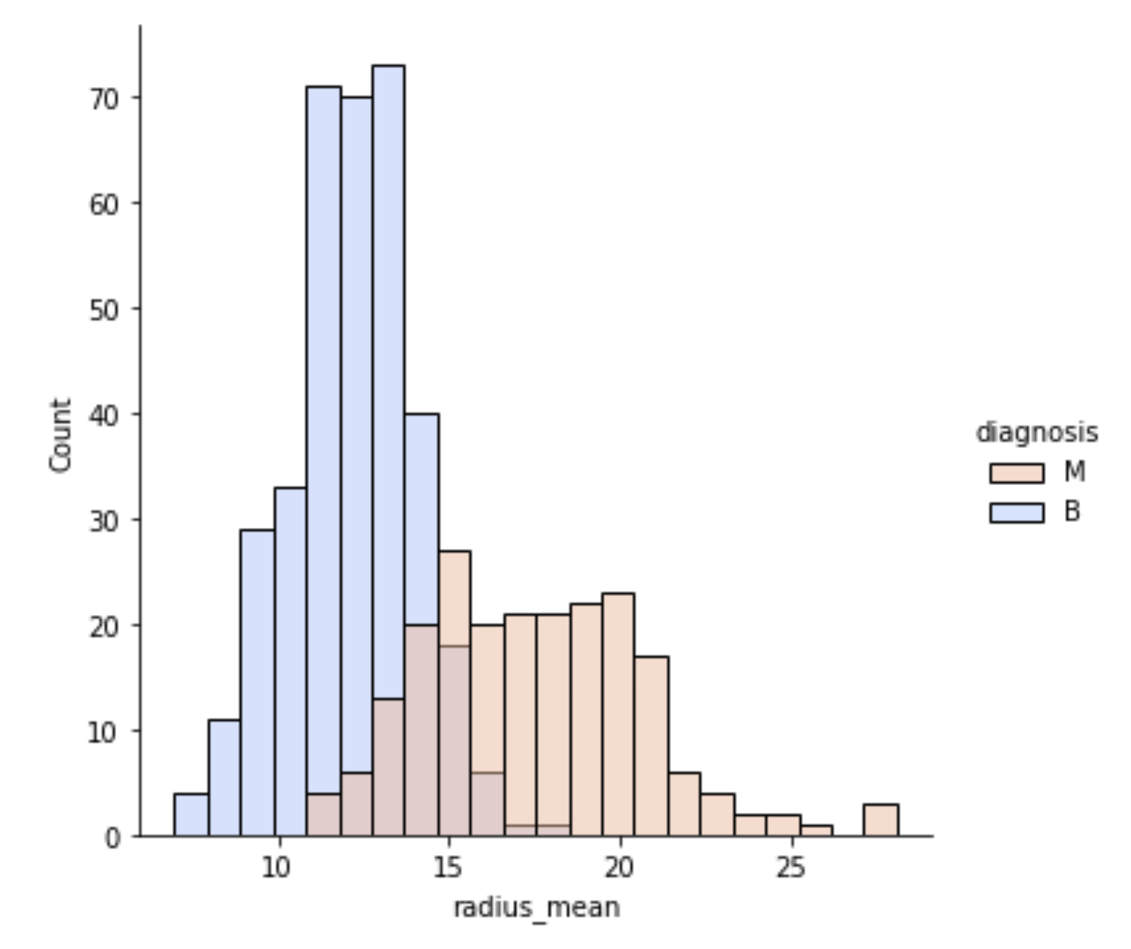
Observing Data
There were no null values in the data.
Separated the data by benign and malignant and narrowed rows to the mean of a characteristic for the image of each mass.
Looked to see that the data was evenly distributed. Showed in overlapping distribution graphs for each characteristic for malignant and benign masses.

Slide 7
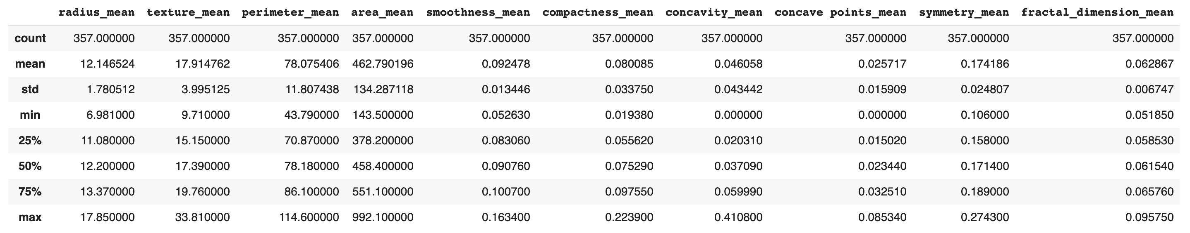
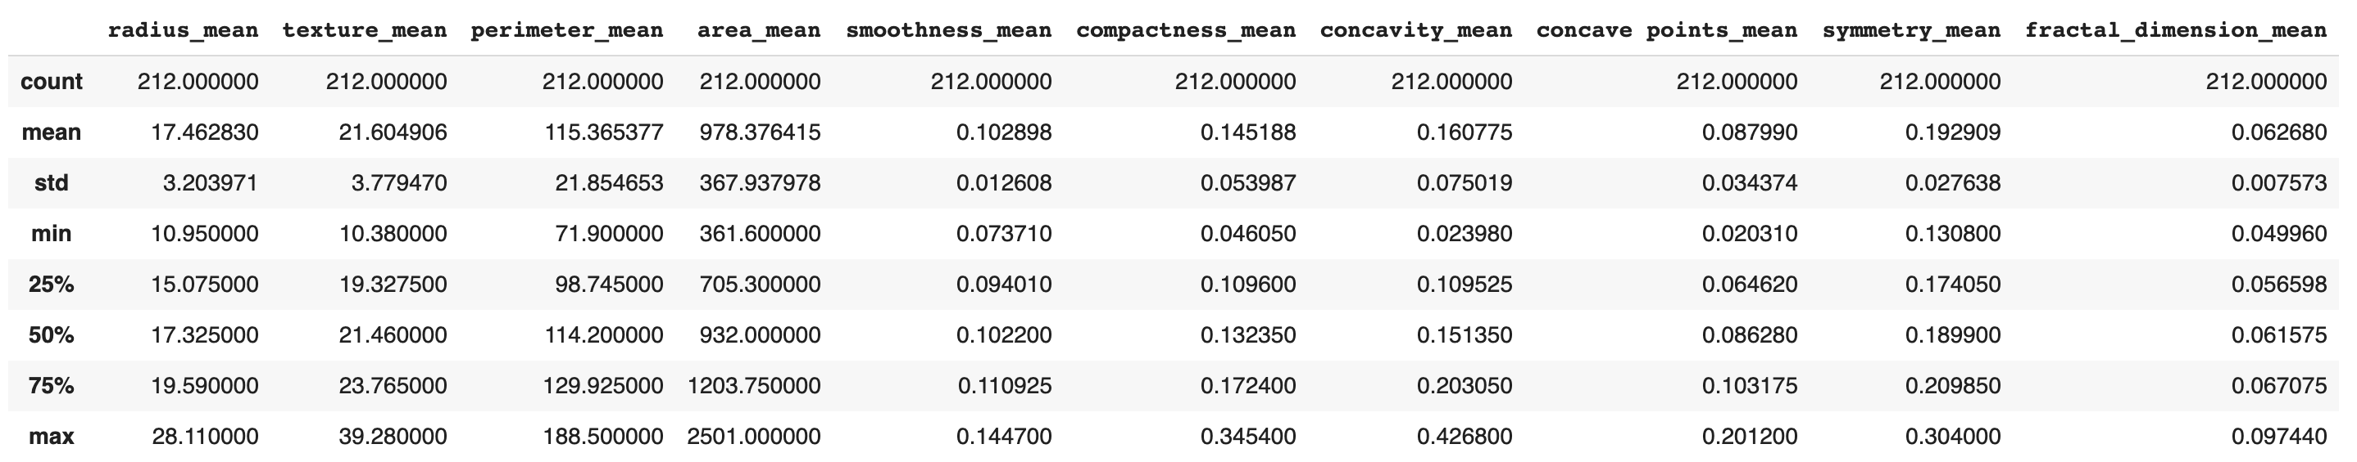
Descriptive Statistics
Benign
Malignant

Slide 8
Statistical T-test results
Comparing benign and malignant results for each characteristic
radius_mean statistic=-25.435821610057054 pvalue=8.465940572262422e-96
texture_mean statistic=-10.86720108146434 pvalue=4.0586360478980736e-25
perimeter_mean statistic=-26.405212979192665 pvalue=8.43625103617473e-101
area_mean statistic=-23.938687235690992 pvalue=4.734564310307344e-88
smoothness_mean statistic=-9.146098808149038 pvalue=1.0518503592032013e-18
compactness_mean statistic=-17.69839197688993 pvalue=3.9382631058873895e-56
concavity_mean statistic=-23.103963430622642 pvalue=9.966555755072963e-84
concave points_mean statistic=-29.354318592113618 pvalue=7.101150161057422e-116
symmetry_mean statistic=-8.338311789592808 pvalue=5.733384028466827e-16
fractal_dimension_mean statistic=0.30571112978583087 pvalue=0.7599368037256238

Slide 9
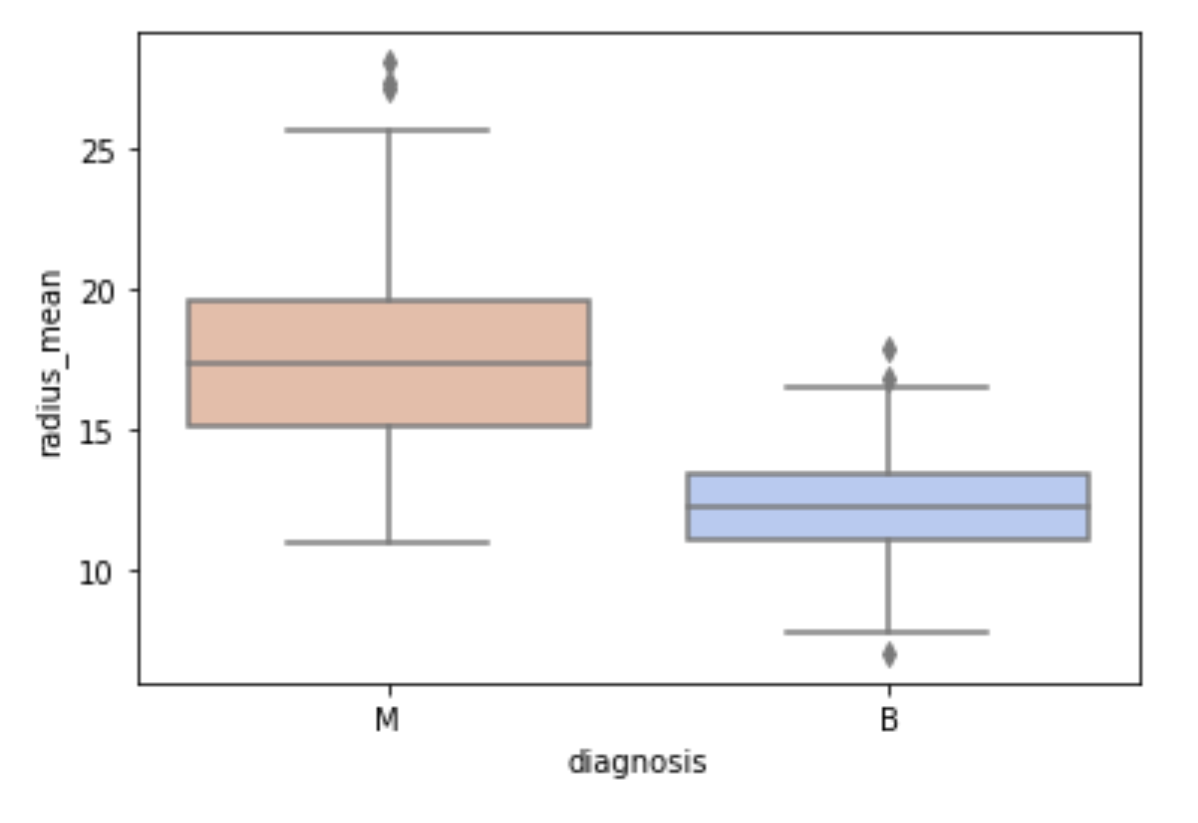
Malignant and Benign Boxplot
When the boxes overlap then the data will be similar.
Here the boxes do not overlap and so the data is fairly different.

Slide 10
Using the Data
A grading score sheet for the characteristics uses the first nine characteristics to determine if the mass is benign or malignant.
1. Comparing the characteristic mean to see if >25% of the malignant data for the characteristic.
2. Total the number of characteristics that are >25% for a mass.
3. If 4/9 are >25% of the malignant data for the characteristic, then most likely the mass is malignant; otherwise the mass is most likely benign
The grade scoring of the mass will accurately diagnose 92% of the time.
A false diagnosis will result in a false negatives 40% of the time and a false positive 60% of the time

Slide 11
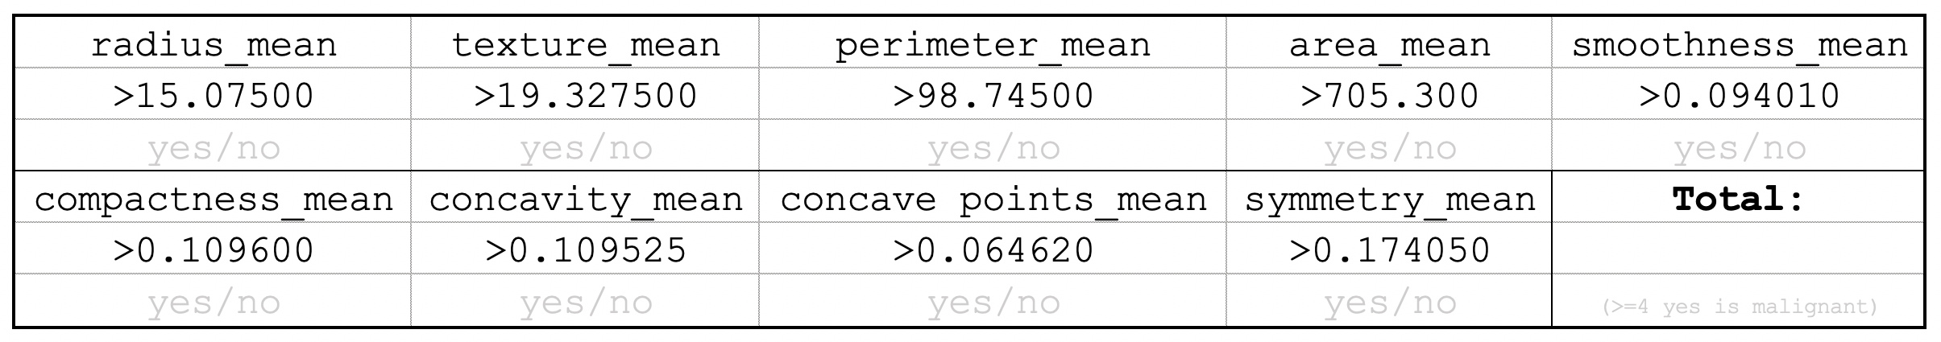
Score Sheet

Slide 12
Conclusion
In conclusion we can see that there are generalities that can be made. But that each characteristic by its self is not conclusive in identifying the mass's status as benign or malignant.
There are many options and opportunities to use this information to help identify cancer and create accurate treatment plans to expedite the healing to help save lives. As a side benefit, this will also reduce costs in hospitals and insurance plans and premiums.

